Slide 1
Selection statements
Lecture 7
Week 4

Slide 2
Line 1
Line 2
So far we have viewed programs as sequences of instructions that are followed one after another
Line 3
Line 4

Slide 3
Line 1
Line 2
Sometimes we need to alter the sequential flow of a program to suit a particular situation
Line 3
Line 4

Slide 4
if statements
Control structures allow us to alter the sequential program flow
Control Structures

Slide 5
if statements
Line 1
If condition is False
condition
Control Structures
If condition is True
conditional code
Line 3

Slide 6







Exercise
Write a program to:
Read the temperature in Celsius
Print a warning when the weather is extreme
A temperature above 32 degrees causes a hot weather warning
A temperature below 4 degrees causes a cold weather warning
Temperature warnings

Slide 7
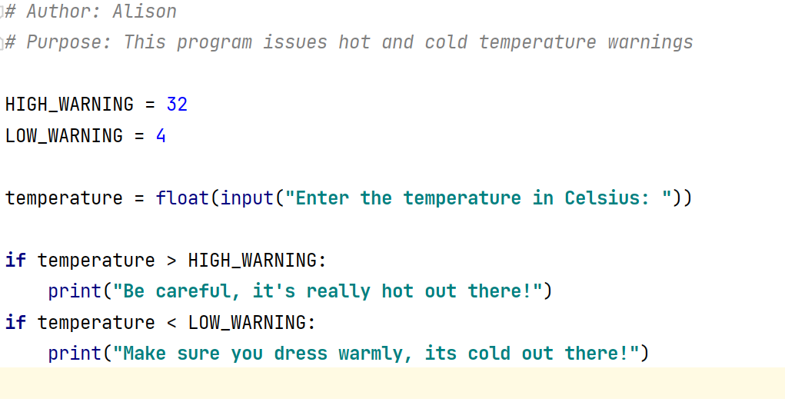
Named constants make the code easier to read and edit
This condition is evaluated to true or false
The indented code is implemented if the condition is True

Slide 8
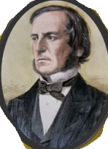
Relational operators and Boolean Expressions
A condition is also called a Boolean Expression and is any variable or calculation that results in a True or False condition.
Boolean Expressions
Boolean expressions use relational operators i.e. operators that relate two values to each other.
George Boole 1815-1864

Slide 9
Expression | Meaning
x > y | True is x is greater than y
x < y | True if x is less than y
x >= y | True is x is greater or equal to y
x <= y | True if x is less or equal to Y
x == y | True if x is equal to y
x != y | True if x is not equal to Y
Python’s relational operators

Slide 10
7 > 5
6 > 6
5 < 10
5 <= 5
7 != 5
6 == 6
5 !=5
5 = 5
True
False
True
True
True
True
False
Assignment

Slide 12
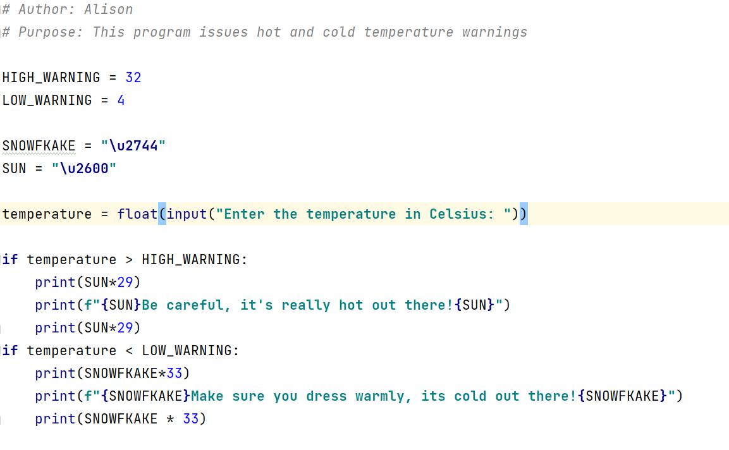

Slide 13
Student Feedback
Please record
The things that are working well in this course
Something that needs to be addressed in this course
SOFT6018 Review

Slide 14
Concept Review
if statement syntax requires a colon and indented code
Control structures allow non sequential flow
if <condition>:
# executed if true
# executed if true
Boolean expressions evaluate to true or False

